Slide 1
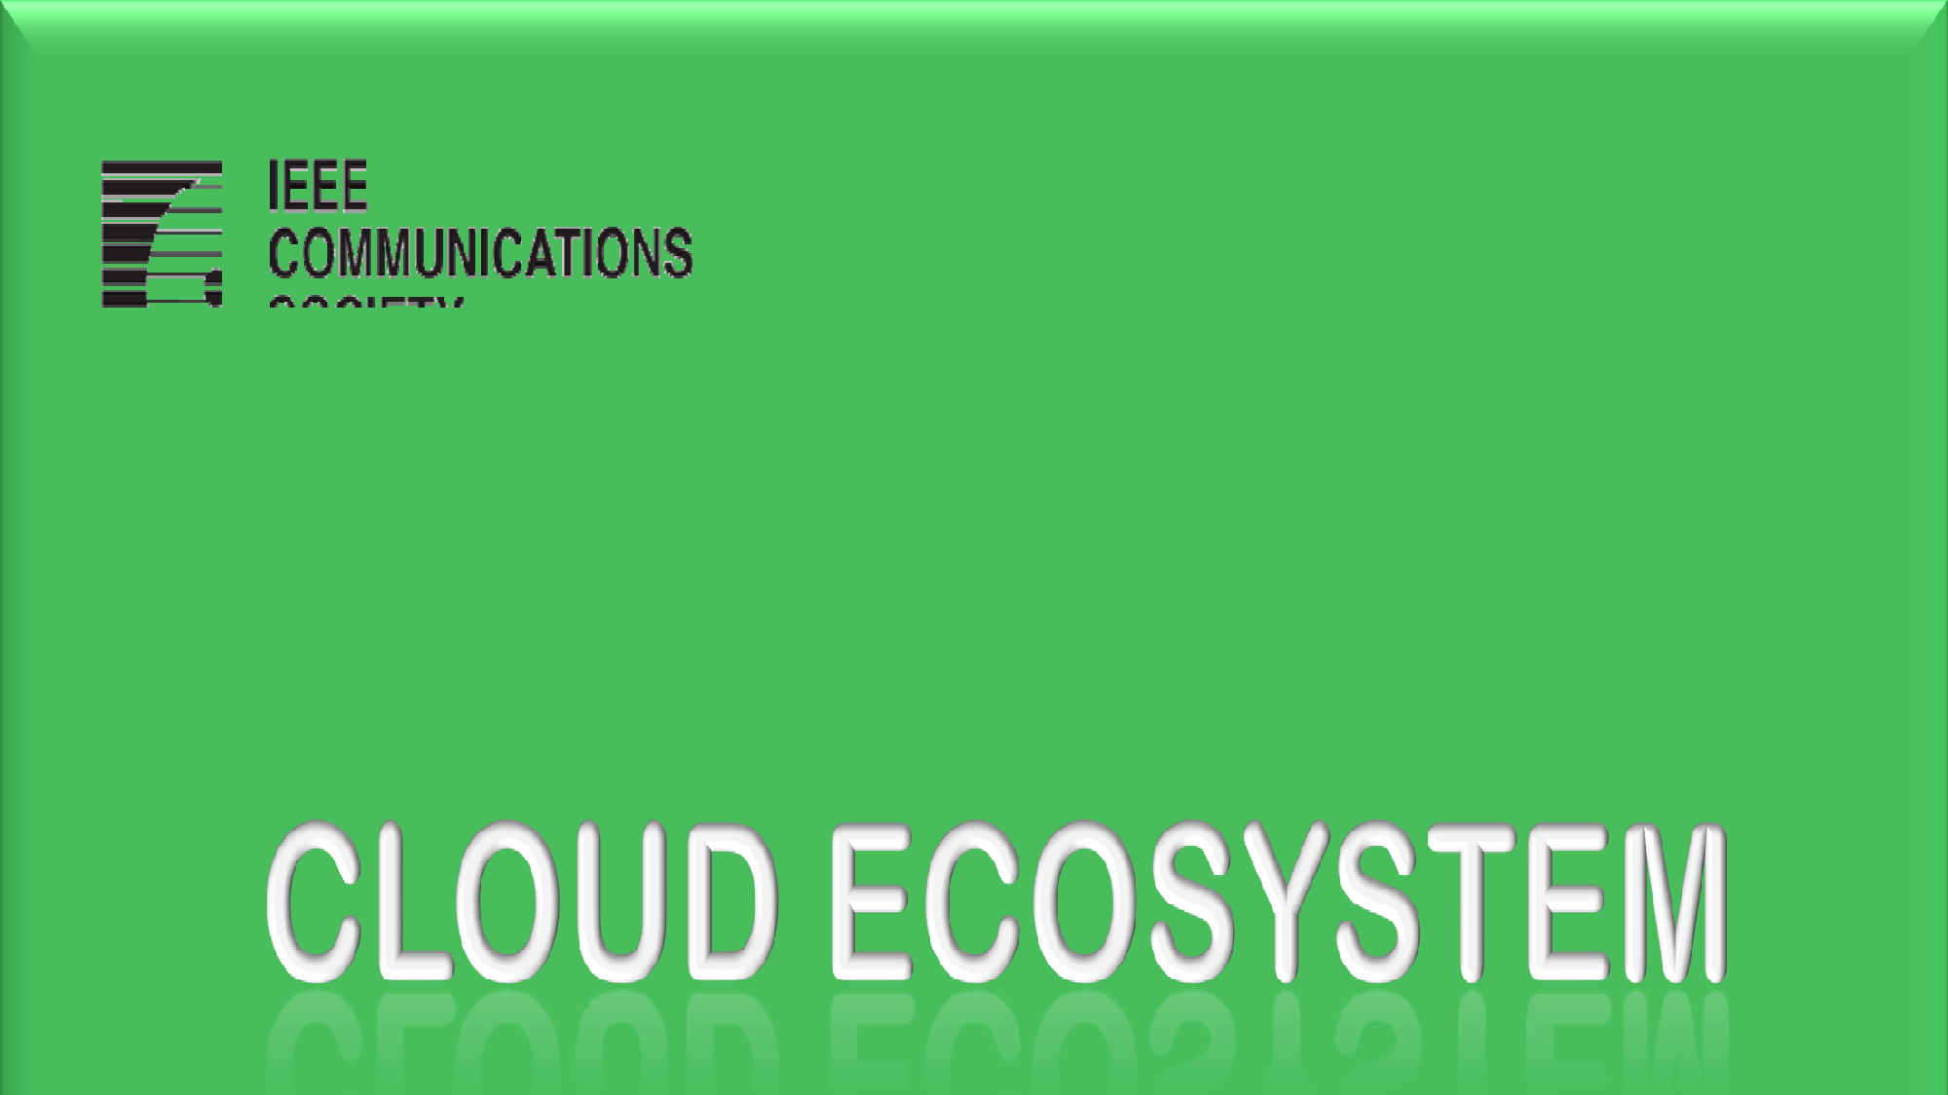


Presented by:
Ngosa Gathams
© Bandung -Indonesia 2012
IEEE – Cloud Computing IT Telkom

Slide 2


Cloud Computing Ecosystem

Slide 3
ECOSYSTEM
WHAT IS AN ECOSYSTEM?
WHO MAKE THE ECOSYSTEM
WHY IS IT IMPORTANT ?

Slide 4


Cloud Ecosystem Actors:
Cloud Service User
Cloud service user (CSU): A person or organization that consumes delivered cloud services.
A CSU can include intermediate users that will deliver cloud services provided by a cloud service provider (CSP) to actual users of the cloud service, i.e. end users.
End users can be persons, machines, or applications.
Photograph: Urbanmyth/Alamy

Slide 5
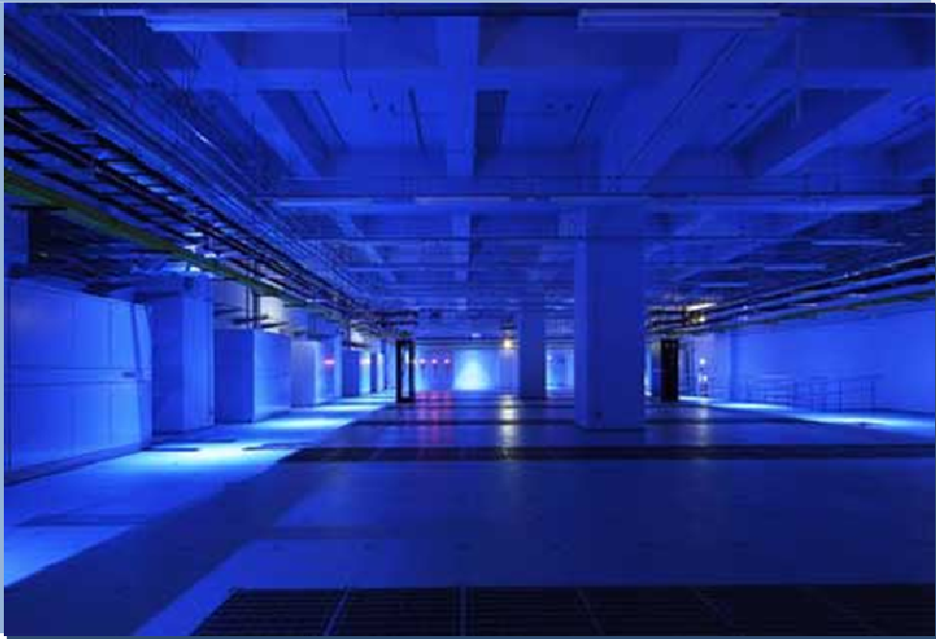
Cloud Ecosystem Actors:
Cloud Service Provider
Cloud service provider (CSP): An organization that provides and maintains delivered cloud services.
Picture ; Equinix

Slide 6
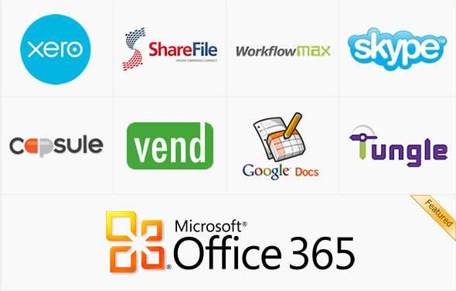
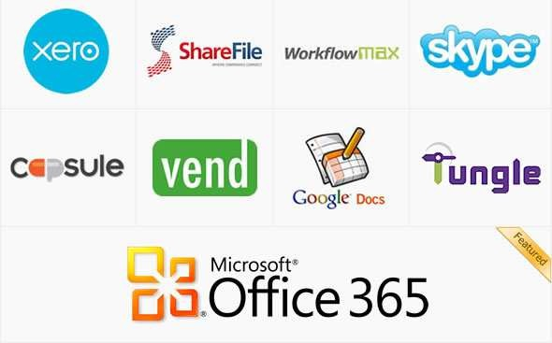
Cloud Ecosystem Actors:
Cloud Service Partner
Cloud service partner (CSN): A person or organization that provides support to the building of the service offer of a CSP (e.g. service integration).

Slide 7
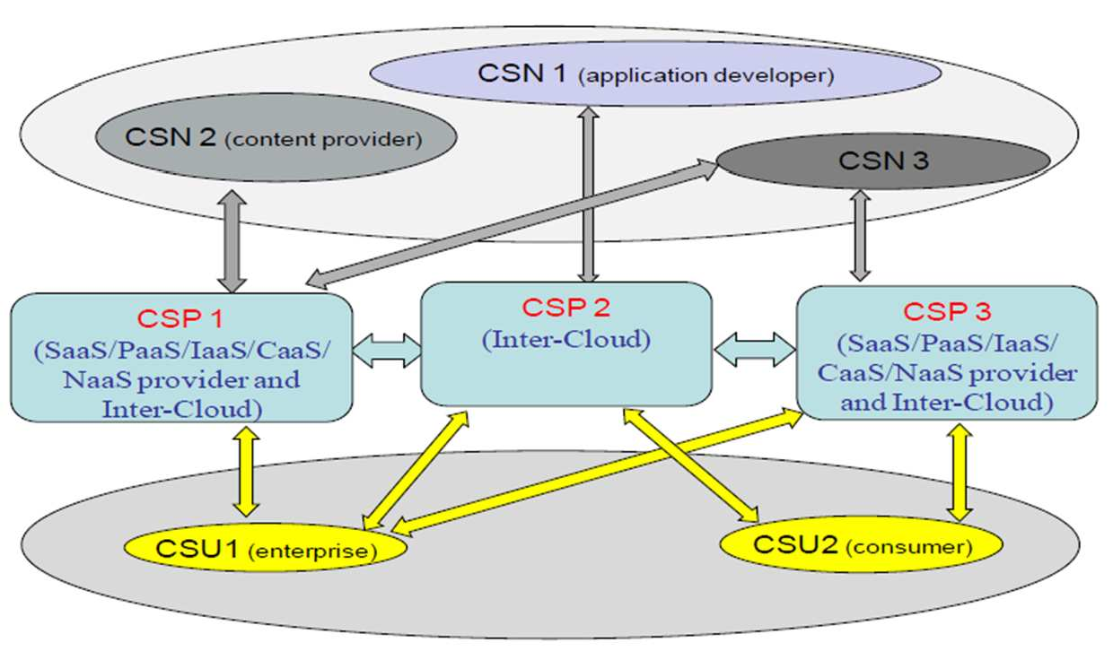
Actors with some of their possible roles in a cloud ecosystem

Slide 8
Possible roles in a cloud ecosystem:
CSU and CSN
Cloud service user (CSU):
  Consumer,
  Enterprise (including enterprise administrator),
  Governmental/public institution
Cloud service partner (CSN):
  Application developer,
  Content provider,
  Software provider,
  Hardware provider,
  Equipment provider,
  System integrator,
  Auditor

Slide 9
Business-value chain in a cloud ecosystem (1/3)
Currently, the business-value chain in a cloud ecosystem is shared among the following actors:
The cloud service partners playing the role of resource suppliers, supply hardware and/or basic software to the cloud service providers.
The cloud service providers provide virtual and/or physical computing capability, storage, communication facilities, API and/or application resources to cloud service users, i.e., the provision of infrastructure (IaaS and NaaS), platform (PaaS) and/or application services (SaaS and CaaS).

Slide 10
Business-value chain in a cloud ecosystem (2/3)
CSP and CSN purchase hardware and basic software from cloud service partners playing the role of hardware and software providers and provide resources/services to other cloud service partners (e.g. playing the role of application developer) and/or the cloud service users.
  They also integrate applications from cloud service partners so as to provide application resources/services to the other cloud service providers (playing one or more of the possible CSP roles, including the role of inter-cloud) and/or the cloud service users.
  They are in the core position in the business-value chain.

Slide 11
Business-value chain in a cloud ecosystem (3/3)
The cloud service partners playing the role of hardware and software providers supply hardware and/or basic software to the cloud service providers and those playing the role of application developers utilize the virtual and/or physical computing capability, storage, communication facilities and/or API resources provided by the cloud service providers to develop applications.
The cloud service users do not utilize their purchased cloud services to generate additional value. The cloud service users purchase cloud services from cloud service providers.
The large enterprises and institutions usually buy either private or public cloud services, while the small and medium enterprises as well as individual persons usually buy public cloud services.

Slide 12

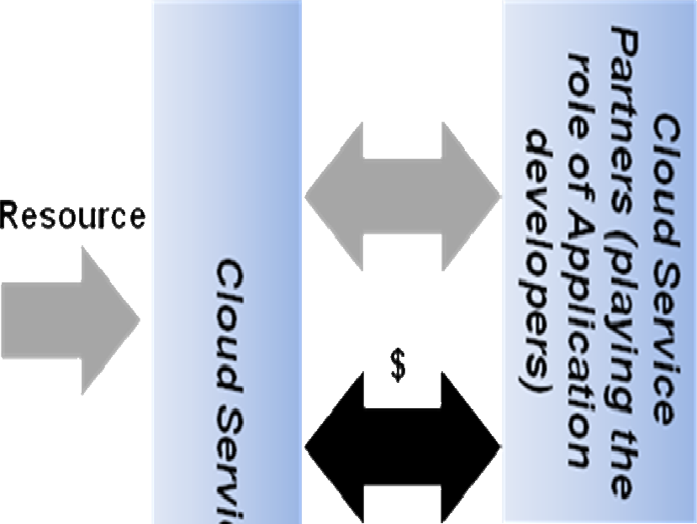





Example of business-value chain between actors of a cloud ecosystem

Slide 13
Scenarios of cloud interaction
involving the inter-cloud role
Inter-cloud scenario with QoS Control
Inter-cloud scenario with Cloud Service Composition

Slide 14
Inter-cloud scenario with QoS Control
(1/2)
In this scenario CSPs are enabled to play the role of Inter-Cloud with QoS control for cloud services.
An example of inter-cloud scenario with QoS control is the following.
The CSP playing the Inter-Cloud role supports the capability to monitor the QoS of Cloud services offered by different Cloud Service Providers, and chooses the most suitable CSP to provide the requested service.
When the CSP playing the role of Inter-Cloud receives a service request from the originating CSP, it processes the request.
– This process takes into account the originating CSP’s QoS requirements (the request information may include service type information, the required QoS parameters information, etc.) and the candidate terminating CSP(s)’ resource status (eventually monitored or got from other Inter-Clouds). Then, the CSP returns the result to the originating CSP.

Slide 15



Inter-cloud scenario with QoS Control
(2/2)
For example, in case of strict bandwidth requirements, resource reservation of the candidate terminating Cloud Service Provider(s) can be applied in addition to monitoring their resource status. This process includes resource reservation for the multiple candidates, acknowledgement for the selected one, and release for the un-selected ones.
QoS control needs further study (e.g. performance monitoring not only at network-level but also at storage- and process-level).

Slide 16
Inter-cloud scenario with
Cloud Service Composition
Cloud service composition enables the CSP to play the role of Inter-Cloud in order to provide a service to the originating CSP via mechanisms by which multiple services offered by different CSPs are invoked under the control of a service logic (the service logic describes the order of the invoking of services and the related parameters).
There are two different kinds of cloud service composition:
  static and dynamic cloud service compositions.

Slide 17
Static cloud service compositions.
For static cloud service composition, the CSP playing the role of Inter- Cloud uses a concrete service logic specifying concrete services, interface invoking information, data flow (services input/output parameters) and control flow (services invoking order) of the services.
The concrete service logic is given by the originating CSP (Arrow (1)).
The CSP playing the role of Inter-Cloud invokes these concrete services according to the data flow and control flow and gets the results of these services. The service may comprise resources and capabilities of multiple CSPs (Arrows (2), (3), (4), and (5)).
The CSP playing the role of Inter-Cloud then composes the entire service as the final result and returns it to the originating Cloud Service Provider (Arrow (6)).

Slide 18
Dynamic cloud service compositions.
For dynamic cloud service composition, the CSP playing the role fo Inter- Cloud uses an abstract service logic specifying service classes (different services which provide the same service function belong to the same service class), data flow and control flow of these services.
The abstract service logic is given by the originating CSP (Arrow (1)).
The CSP playing the role of Inter-Cloud translates the abstract service logic into the concrete service logic before searching the concrete services that can fulfill the requirements.
Specifically, the translation is to replace the service classes with concrete services and create interface invoking information for the services.
Then the CSP playing the role of Inter-Cloud executes the concrete service logic and gets the results of the services. Finally, it composes the entire service as the final result and returns it to the originating CSP.

Slide 19



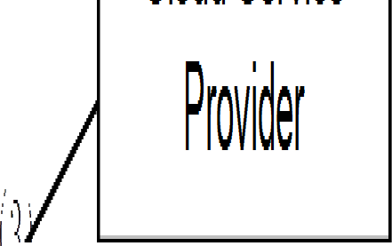





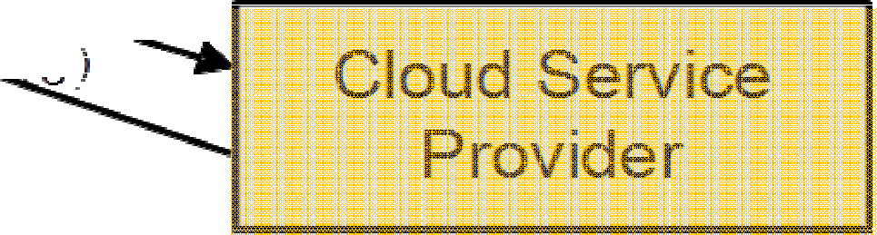
Inter-cloud scenario with Cloud Service Composition

Slide 20
Scenarios of inter-cloud
This clause provides scenarios of inter-cloud involving the different inter- cloud roles identified before.
Scenario with inter-cloud peering
Scenario with inter-cloud federation
Scenario with inter-cloud service broker

Slide 21


Scenario with inter-cloud peering
Two CSPs interwork directly with each other. Each CSP exposes its own API for cloud interworking, and the CSPs interwork with each other directly by using the other CSP’s API.
In this figure , CSP A interworks with CSP B using API provided by CSP B and vice versa.
Cloud Service provider A
Cloud Service provider B
API(B)
API(A)
API(X): API provided by Cloud Service provider X

Slide 22





Scenario with inter-cloud federation
Mutually trusted CSPs logically join an alliance together.
The common API for cloud interworking is defined in the alliance, and each CSP interworks with other CSPs in the alliance through the common API.
Cloud Service
provider A Common API
Cloud Service provider B
Common API
Cloud Service provider C
Common API

Slide 23
Scenario with inter-cloud service broker
The scenario of Inter-cloud with Inter-Cloud Service Broker is shown in next figure.
In this scenario, the CSP playing the inter-cloud service broker role receives a cloud service request from a cloud service provider or a cloud service user through its own API.
The CSP playing the role of inter-cloud service broker interworks with one or more other CSPs and provides brokering service functions by integrating services provided by these CSPs.
Interworking between the CSP playing the inter-cloud service broker role and the other CSPs is established by either inter-cloud peering or inter- cloud federation.

Slide 24
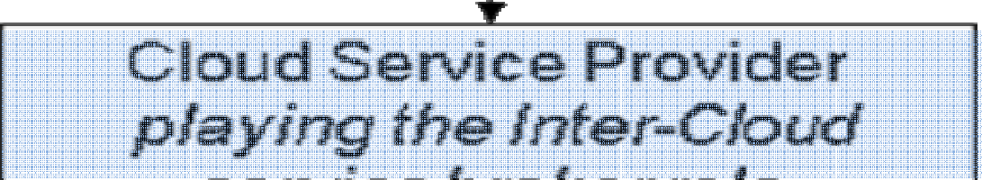
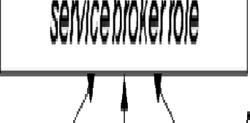
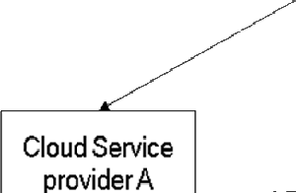
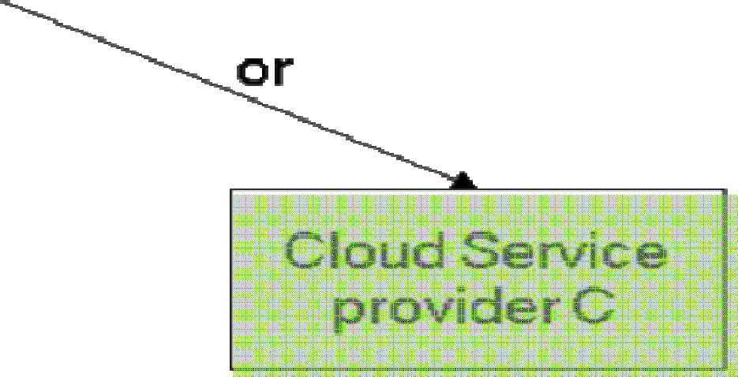

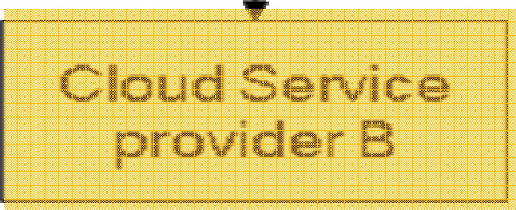
Scenario with inter-cloud service broker

Slide 25
Contents
•
•
•
•
Basic Definition
Cloud Ecosystem Actors
CC Essential Characteristics Cloud service categories
Opportunities
Possible Roles
Business aspects
Inter-cloud scenario
Cloud Services Mapping
Use Case
DaaS
SLA
Cloud deployment models
Inter-cloud
CC model

Slide 26

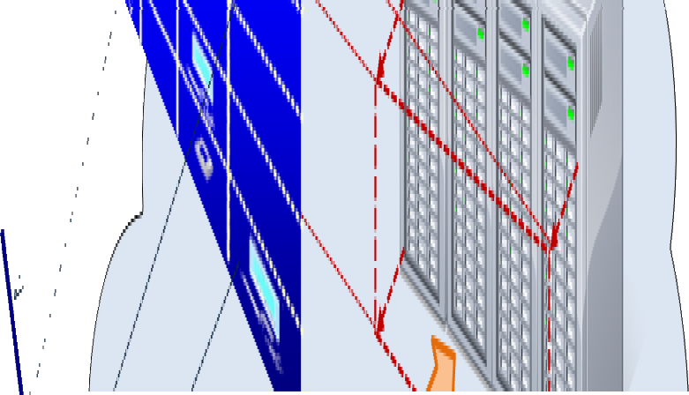












DaaS
DaaS is defined as the capability provided to the CSUs to use virtualized desktops from a CSP in the form of outsourcing.

Slide 27
DaaS
Instead of maintaining and running desktop operating system and applications on the local storage of remote clients, a central server located in the cloud retains the virtualized desktops and all of the used applications and data are kept and run centrally.
Based on application streaming and virtualization technologies, CSUs can access desktop operating system and applications through a completely hosted system.

Slide 28
Key characteristics of DaaS:
Enhanced management and security
Since all applications actually run in a central server, they are much more secure than if they were installed on each user’s PC because the cloud service provider can focus more on patches and virus protection.
In addition, the user’s IT department no longer needs to worry about support and maintenance of a high number of individual desktops.

Slide 29
Key characteristics of DaaS:
Lower TCO (Total cost of ownership)
By placing emphasis on the data centre rather than individual devices, DaaS promotes longer hardware life.
Organizations or enterprises seeking to avoid additional costs can switch part of their IT infrastructure from capital expenditure (CAPEX) to operating expenditure (OPEX), as they now pay for virtualized desktops.
Also, by decoupling the desktop operating system from the hardware, smaller and cheaper PCs or even thin clients can be employed, leading to substantial savings.

Slide 30
Key characteristics of DaaS:
Preservation of the rich client experience
DaaS can provide an uncompromised client experience.
This is due to the fact that it leverages a hypervisor layer which enables the hosting of authentic client OSs (i.e. Windows XP, Vista, etc.).
Conversely, shared service environments offer a client experience that may compromise between application compatibility and user personalization.

Slide 31
Key characteristics of DaaS: Separation of service-provider and service-user responsibilities
DaaS allows clean separation between the responsibilities of the cloud service provider and the cloud service user.
The cloud service provider is responsible for everything up to the virtualized desktops (i.e. servers, storage, virtualization software, etc.), and the cloud service user is responsible for everything inside the virtualized desktops (i.e. OS image/licensing, application packaging/licensing, user profiles, etc.)

Slide 32
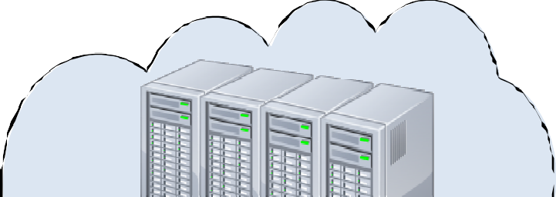


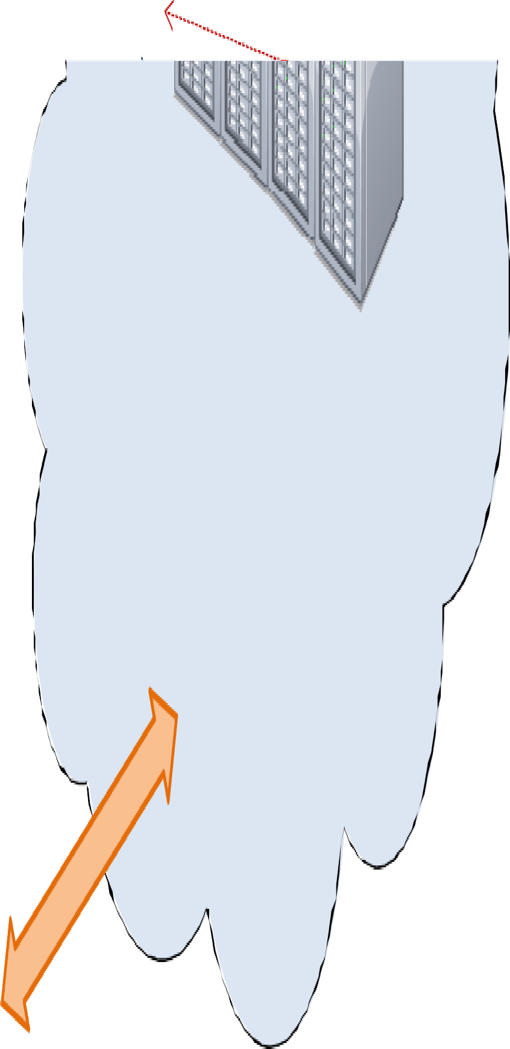


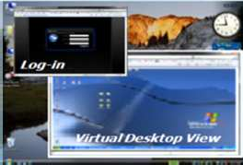







General use case of DaaS
High level figure describing the use case
Cloud Service Provider
Virtualized Desktops
Virtualized Desktops
Cloud Infrastructure
Consumer
Enterprise

Slide 33
General use case of DaaS
Use case description
Between a consumer and a CSP:
In this scenario, a consumer accesses and uses data or applications in a CSP which offers virtual desktop service.
A consumer can enjoy the environment with all programs and applications which are identical with those of traditional PCs.
Of course, the consumer can choose the virtual hardware specification of its virtual desktops.
If necessary, the environment (i.e. operating system) can be changed to another one immediately.
All the consumer has to do is keeping up with a password since all data are totally stored and managed in the CSP.

Slide 34
General use case of DaaS
Use case description
Between an enterprise and a CSP:
An enterprise using virtual desktop service from a CSP for its internal processes is included in this use case.
In this scenario, the enterprise can select applications or OS in the DaaS service for certain enterprise functions.
Unlike the use case between a consumer and a CSP, the enterprise normally uses storage for backups.
Also, the enterprise can overcome peak loads and save energy by requesting the CSP online to increase or decrease the number of virtual desktops, respectively.

Slide 35
General use case of DaaS
Use case description
Among an enterprise, a consumer, and a CSP:
In this scenario, the enterprise makes the consumer do works with its internal processes at the outside of the enterprise by transferring virtual desktops and related data through the CSP.
Contrary to above two scenarios, the consumer cannot select applications freely and more limitations to access data in the enterprise may exist than at inside of the enterprise.
Whenever the consumer connects with the CSP, the CSP sends feedback data to the consumer by accessing the enterprise to handle or bypass corresponding data.

Slide 36
General use case of DaaS
Information flow
Between a consumer and a CSP:
The consumer should send information about authentication (i.e. password).
The CSP offers virtual desktop environment of corresponding data such as OS, applications, and user data by virtual desktop delivery protocol (VDDP).
In case of the consumer’s change in the virtual desktop environment including virtual hardware specification, the consumer can transfer additional information related with selection.

Slide 37
General use case of DaaS
Information flow
Between an enterprise and a CSP:
This case is similar to that between a consumer and a CSP except controlling the number of the virtual desktops.
The enterprise can send warning information when abnormal situation (i.e. peak load) occurs.

Slide 38
General use case of DaaS
Information flow
Among an enterprise, a consumer, and a CSP:
Information for authentication flows from the consumer to the enterprise through the CSP.
Once the consumer is identified, information regarding internal processes is transferred to the CSP and it is dispatched to the end-user by VDDP.
The consumer’s output data is stored to the CSP or the enterprise but there is no path for selection information as in the first case since the consumer cannot have an authority to alter the virtual desktop environment.

Slide 39
General use case of DaaS
Derived requirements for the cloud ecosystem
Consumers require accessing their desktop environments independently of locations, indeed, with their various devices.
Desktop environment needs to guarantee the business continuity and a recovery solution about a system failure.
Consumers desire to use their personal tasks separating business computing.
Consumers eager to run various applications as in traditional PCs.

Slide 40
Other related definitions:
Service Level Agreement (SLA)
SLA : An abbreviated service agreement stating the technical performance promises made by a provider, including remedies for performance failures.
An SLA is composed of three parts.
  The first part is a collection of promises made to subscribers,
  (2) a collection of promises explicitly not made to subscribers, i.e., limitations, and
  (3) a set of obligations that subscribers must accept.
In practice, an SLA may contain non-quantitative parameters, such as specific regulations, citizenship requirements, business process standards (e.g. ISO 20000). Cloud services may have different types of SLAs.

Slide 41


SLA for Cloud Computing:
Availability
SLA Item | Description
Service availability, Availability | Probability at which the service is usable ((planned service time - service suspension time) ÷ planned service time)
Average recovery time | Average time from a fault occurrence to completion of its repair (total repair times ÷ number of fault occurrences)
Service suspension time | Recovery time in cases where business continuity measures against expected faults are available
 | Objective of the time needed for recovery from a disaster
Time of data recovery point | Point in time from which data is recovered

Slide 42


SLA for Cloud Computing:
Performance
SLA Item | Description
Online response time | Response time for online processing
Online response time compliance ratio | Percentage of online transactions that have been completed within the target time
Batch processing time | Response time for batch processing
Batch processing time compliance ratio | Percentage of batch processing tasks that have been completed within the target time
Maximum number of processing tasks per unit time | Maximum number of processing tasks per unit time
Compliance ratio of maximum processing tasks per unit time | Percentage of cases where the maximum number of processing tasks per unit time is equal to or has exceeded the target number

Slide 43


SLA for Cloud Computing:
Security (1/2)
SLA Item | Description
Status of the cloud service provider’s acquisition of the relevant security standard | Whether or not the cloud service provider has acquired certification for the information security management system standard: “ ISMS Certification Standards (Ver.2.0) ISO27001”
Status of certification of the party possessing management authority | Whether or not measures have been implemented against threat of information leakage that may be caused by an attacker who has gained management authority
Status of operational restrictions included in security measures taken on the management system | Whether or not there are access restrictions to prevent installation of malicious software that may cause information leakage, and to prevent the setting of unnecessary access paths
Keeping data transmitted between cloud systems confidential | Whether or not data transmitted between clouds are kept confidential
Data location | Storing data at domestic sites

Slide 44


SLA for Cloud Computing:
Security (1/2)
SLA Item | Description
Data location | Storing data at domestic sites
Status of acquisition of a log for detection of malicious acts | Whether or not a log can be acquired to detect malicious access attempts and to enable the taking of necessary measures if such attempts have been detected
Period during which a log is kept for detection of malicious acts | Period during which evidence is kept to confirm any malicious acts conducted or correct processing
Status of communication control to block malicious communication | Whether or not communication control is available to block threat of attacks that use stepping stones and to block information from being taken outside
Status of measures against network congestion to circumvent DoD/DDoS attacks | Whether or not measures to circumvent denial of service attacks are available
Implementation of measures against malware | Whether or not measures to prevent infection by malware are available

Slide 45
SLA Measurement (1/3)
Cloud service users need a way to compare services from competing cloud service providers, as well as with their own internal capabilities to offer appropriate basis for cloud services operations.
"SLA (Service Level Agreement) Management Handbook" provides an approach that can analyze through periodically sampling the performance data in order to form a QoS report for the quality evaluation statistically.
However, this approach doesn’t provide a quantitative evaluation of the QoS, thus it is not able to reflect the quality of service operation in real time.

Slide 46
SLA Measurement (2/3)
In the service quality evaluation process, quantitative assessment which directly reflects the service is essential.
It can be quantified from both the service parameters and customer perception point of view.
Quantitative Units can be described and/or calibrated in terms of linear capability, throughput, or consumption-based

Slide 47
SLA Measurement (3/3)
For computing, there must be a consistent benchmark that is useful for comparison across a wide range of Cloud Subscriber needs.
For storage, measurement units must allow comparison of capacity, performance and quality.
  Quality would be rated by level.
For networks, measurement units must allow comparison of bandwidth, performance and quality.
  Bandwidth can be represented in gigabits/second. Performance can be quantified in latency/jitter/throughput per minute.

Slide 48
SLA life cycle management
SLAs are the contractual basis between the cloud service users and cloud service providers.
They contain details of shared information and service level guarantees that are offered by cloud service providers.
They will play an important role in future cloud development steps.
Cloud service management can be achieved by the effective SLA lifecycle management.

Slide 49
SLA life cycle: 6 Steps
SLA lifecycle can be normally divided into 6 steps:
Product/service Development
Negotiation and sales
Implementation
Execution
Assessment
Decommission
SLA lifecycle should be considered in SLA development.
Different methods are combined to support each step in SLA lifecycle, and different parameters are used for relevant steps.

Slide 50
Requirements of end-to-end QoS
In a cloud computing environment, requirements of end-to-end QoS are different.
The use of SLA guarantees in a product can make the network more customer-focused.
The traditional technical components of SLA are made up of a number of negotiated Service Level Objectives (SLO) which are based on Key Performance Indicators (KPI).
In a cloud environment, KPI is measured by Standard Unit of Measure (SUoM).
SLA-based services are becoming a key requirement for the provisioning of IP-based cloud services in order to ensure QoS.

Slide 51
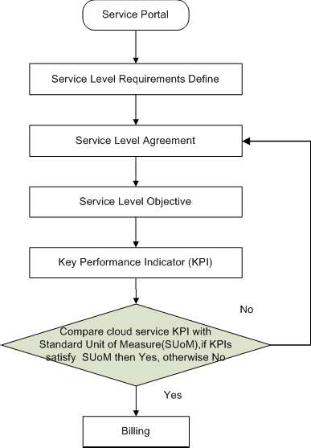
Cloud Service
SLA Lifecycle Management

Slide 52
SLA mapping between CSP-ISB and CSP
This use case deals with the SLA mapping between the CSP playing the Inter-Cloud Service Broker role (CSP-ISB) and other CSPs.
Multiple CSPs will contribute to, or impact concurrently, the SLA between the CSP-ISB and the CSU when an orchestrated service is provided.

Slide 53


SLA mapping between CSP-ISB and CSP
Legend | Use case
Use case title | SLA mapping between CSP (Inter-Cloud Service Broker) and CSP
Relevant actors (played roles) | Cloud Service User (consumer, enterprise, governmental institution), Cloud Service Provider (IaaS provider, PaaS provider, SaaS provider, Inter- cloud Service Broker)
Relevant cloud services categories | IaaS, PaaS, SaaS
Relevant cloud deployment models | Public Cloud

Slide 54
SLA mapping between CSP-ISB and CSP:
Use case description
CSP-ISB is the contact point for CSU, and there is SLA (SLA0) between them.
CSP-ISB integrates services from multiple CSPs, for instance, storage service from CSP-1 and computing service from CSP-2.
There are B2B level SLA between CSP-ISB and CSP-1, CSP-2 respectively (SLA1, SLA2).
For CSP-ISB, in order to guarantee SLA0 for CSU, it needs to map SLA0 to SLA1 and SLA2, because SLA0 is actually implemented by SLA1 and SLA2.

Slide 55




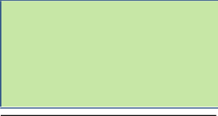



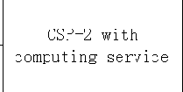
SLA mapping between CSP-ISB and CSP:
Derived requirements for the cloud ecosystem
It should be possible for CSP-ISB and CSPs to negotiate SLAs.
It should be possible for CSP-ISB to coordinate the SLAs from multiple CSPs (which is related with business decision).

Slide 56
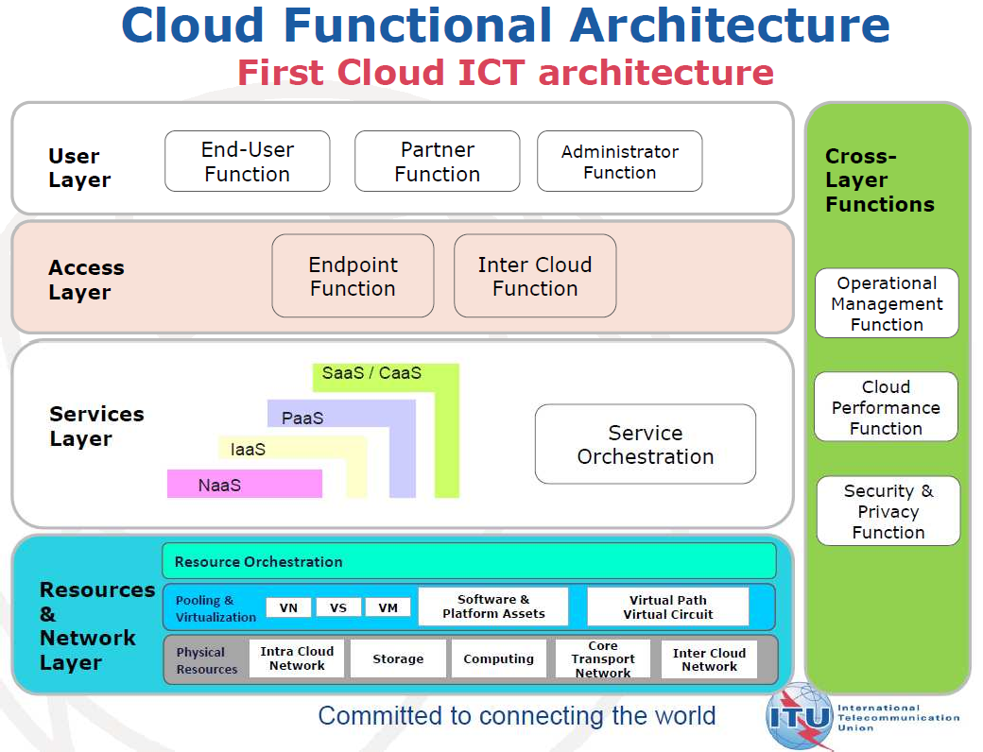
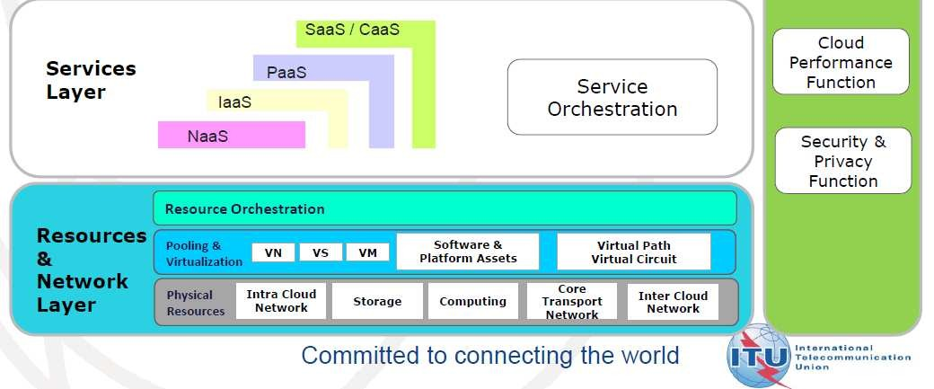

Slide 57

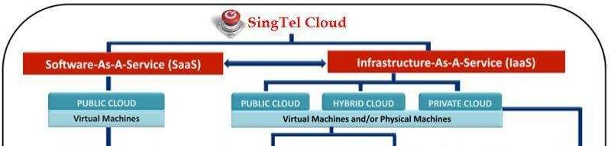
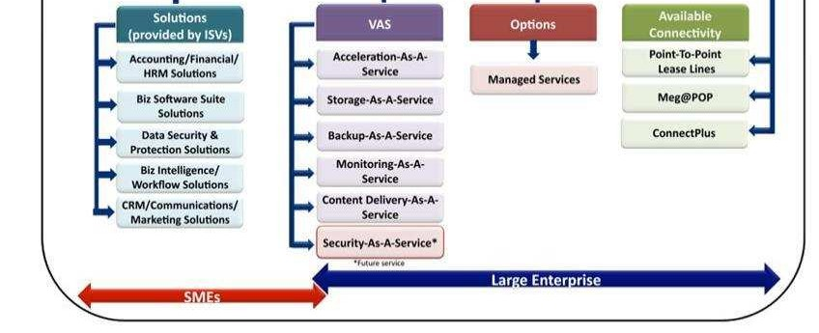

Broad Overview of Alatum’s Cloud Service Offerings

Slide 58
So, Are We Ready,
In today’s era of Tera ?

Slide 59





Thank you
satriyo.dharmanto@conax.com satriyo.dharmanto@gmail.com
© Bandung -Indonesia 2012
IEEE – Cloud Computing IT Telkom

